Slide 1
Defining a Relation Schema in SQL
Data types
VARCHAR is variable length, while CHAR is fixed length.
CHAR is a fixed length string data type, so any remaining space in the field is padded with blanks. CHAR takes up 1 byte per character. So, a CHAR(100) field (or variable) takes up 100 bytes on disk, regardless of the string it holds.
VARCHAR is a variable length string data type, so it holds only the characters you assign to it. VARCHAR takes up 1 byte per character, + 2 bytes to hold length information. For example, if you set a VARCHAR(100) data type = ‘Jen’, then it would take up 3 bytes (for J, E, and N) plus 2 bytes, or 5 bytes in all.
You can see how the use of VARCHAR in most cases is preferred, to save space.

Slide 2
Defining a Relation Schema in SQL
Data types
BOOLEAN : Zero is considered as false, nonzero values are considered as true.
INT / INTEGER: A medium integer.
SHORTINT : Smaller than int
FLOAT / REAL : for typical floating point value
DOUBLE(size, d) : A normal-size floating point number. The total number of digits is specified in size. The number of digits after the decimal point is specified in the d parameter

Slide 3
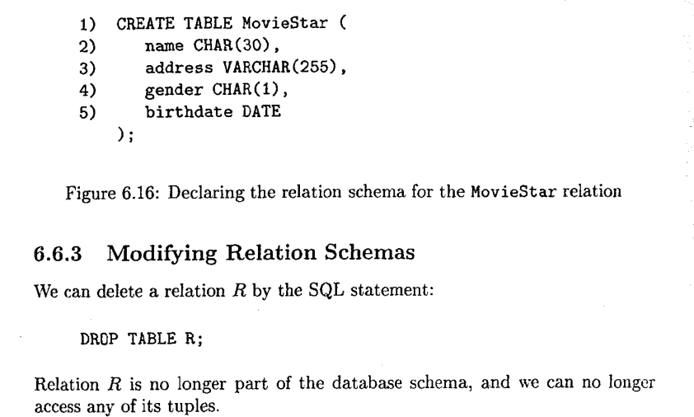
Defining a Relation Schema in SQL
Simple Table Declarations

Slide 4


Defining a Relation Schema in SQL
Alter command

Slide 5

Defining a Relation Schema in SQL
Default Values
In general, any place we declare an attribute and its data type, we may add the keyword DEFAULT and an appropriate value.

Slide 6
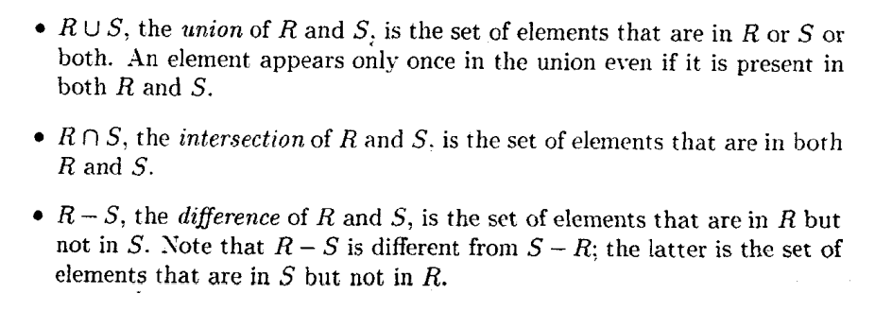
Set operations on Relations

Slide 7
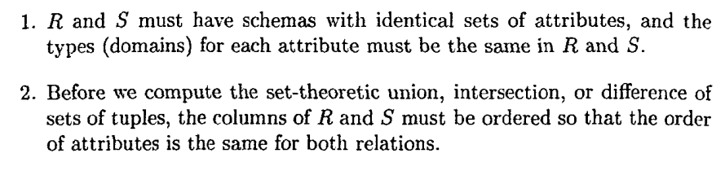
Set operations on Relations

Slide 8
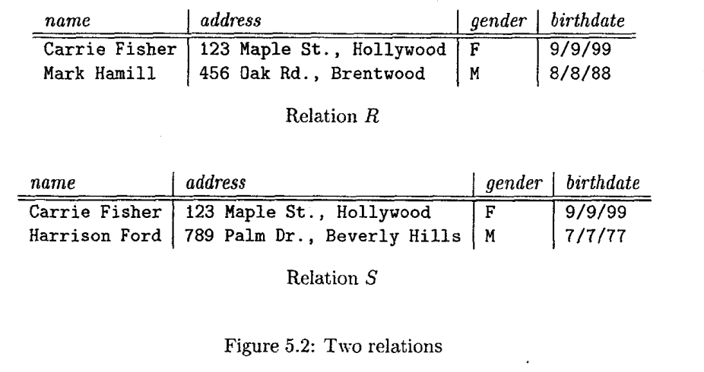
Set operations on Relations

Slide 9

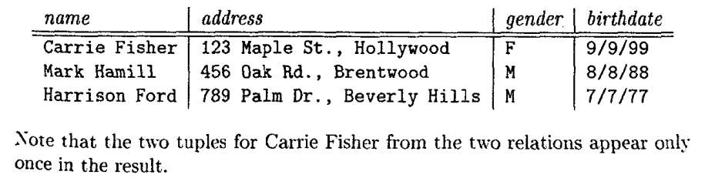
Set operations on Relations

Slide 10
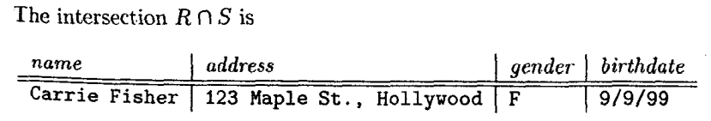
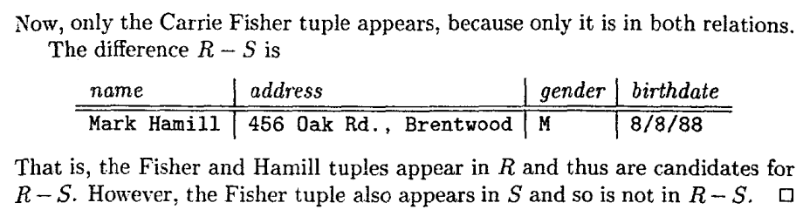
Set operations on Relations

Slide 11
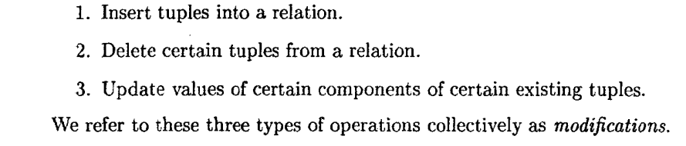
Database Modifications

Slide 12
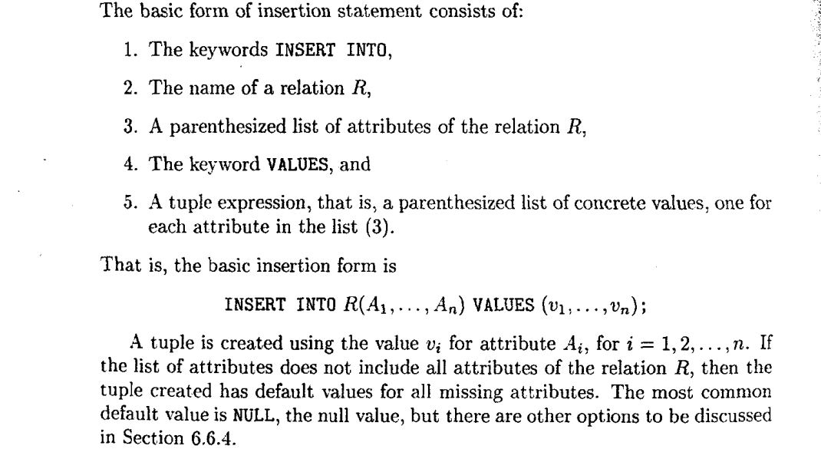
Database Modifications

Slide 13
Database Modifications

Slide 14
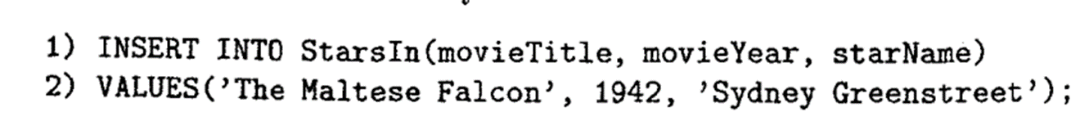

Database Modifications

Slide 15
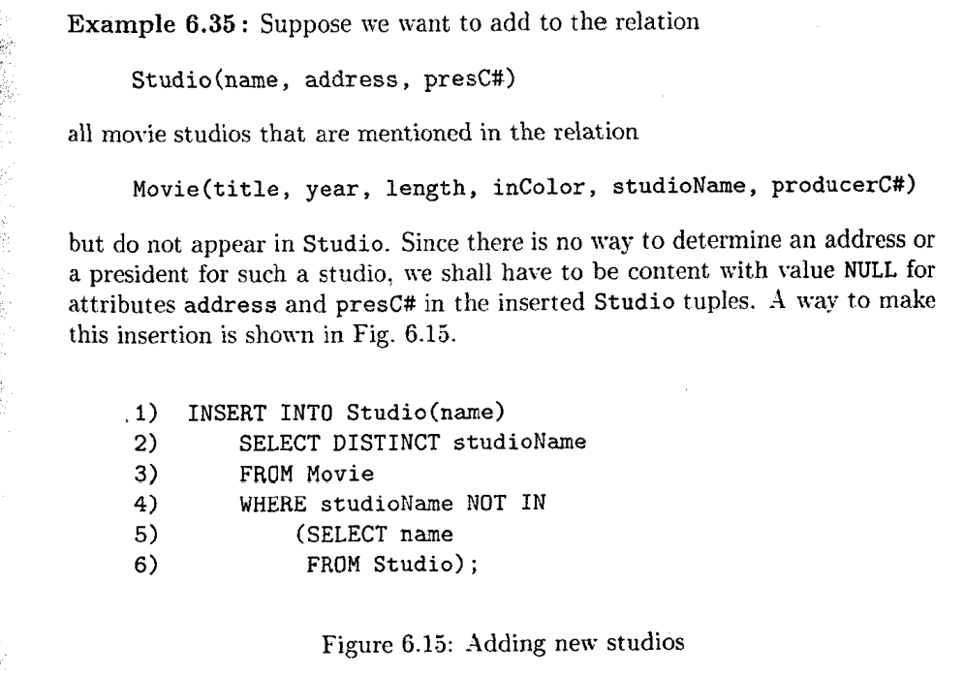
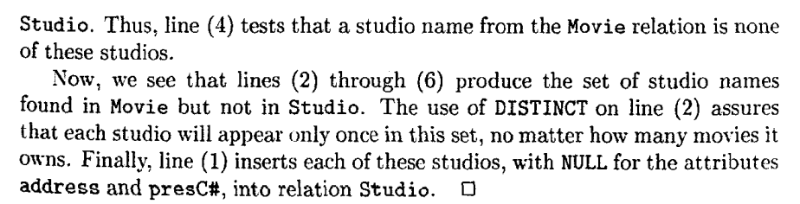
Database Modifications

Slide 16
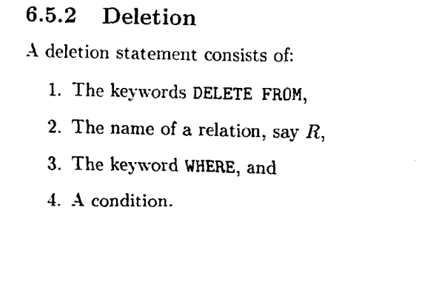
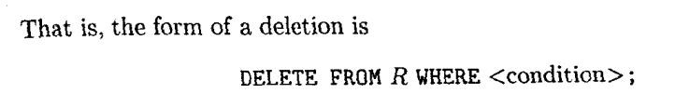
Database Modifications

Slide 17
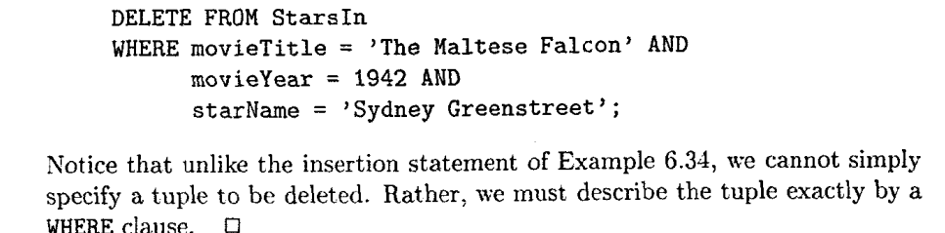
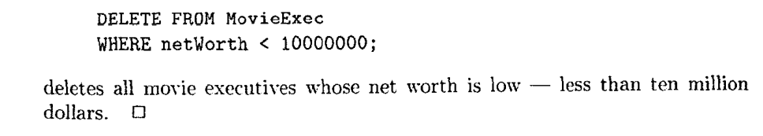
Database Modifications

Slide 18
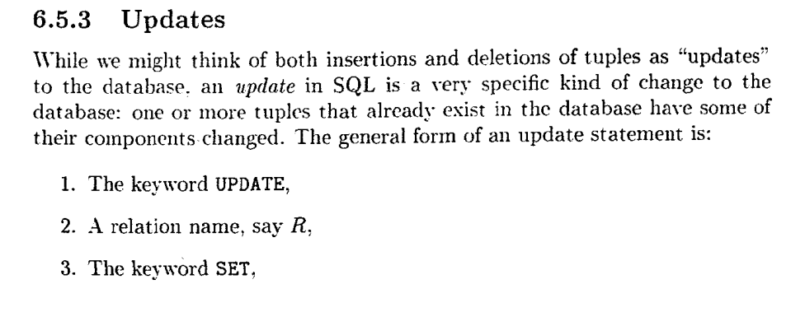
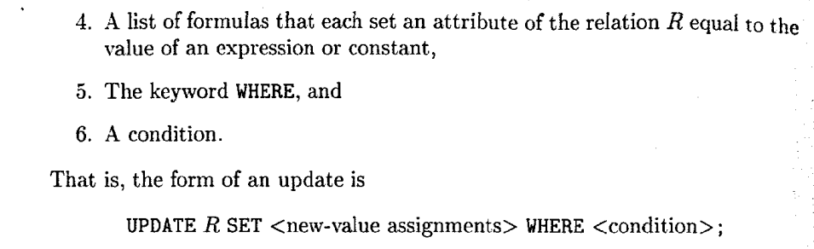
Database Modifications

Slide 19

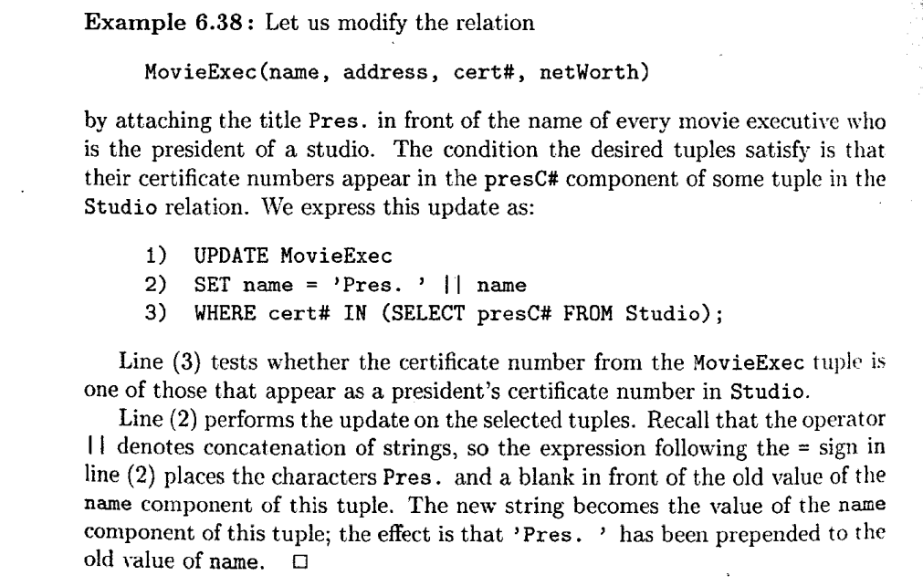
Database Modifications

